Slide 1
Intellectual Property Right
Pravin Kumar

Slide 2
Introduction
Intellectual Property (IP) is any creations of human mind. Like tangible property, their creation has a value and, as with all property, it needs to be protected.
Intellectual Property Rights (IPR) gives them this protection, as well as helping them exploit and control their IP.
“The exclusive right granted by State, to prevent others from using, manufacturing, distributing - inventions, processes, applications, new and original designs, trademarks, new plant varieties, data bases and artistic and literary works”. Such a person is known as ‘rights owner’ or ‘rights holder’.

Slide 3
Nature of Intellectual Property
Creation of human mind (Intellect)
Intangible property
Exclusive rights given by statutes
Attended with limitations and exceptions
Time-bound
Territorial

Slide 4








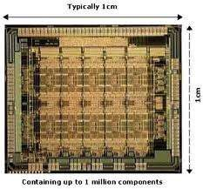


Types of IPRs
Intellectual Property
Industrial Property
Copyrights and related rights
Industrial | Patents Trademarks Trade Secrets | Geographical | Layout Designs of | Plant varieties &
Designs | Service marks | Indications | Semi Conductor ICs | Farmer’s rights
®
©
™

Slide 5
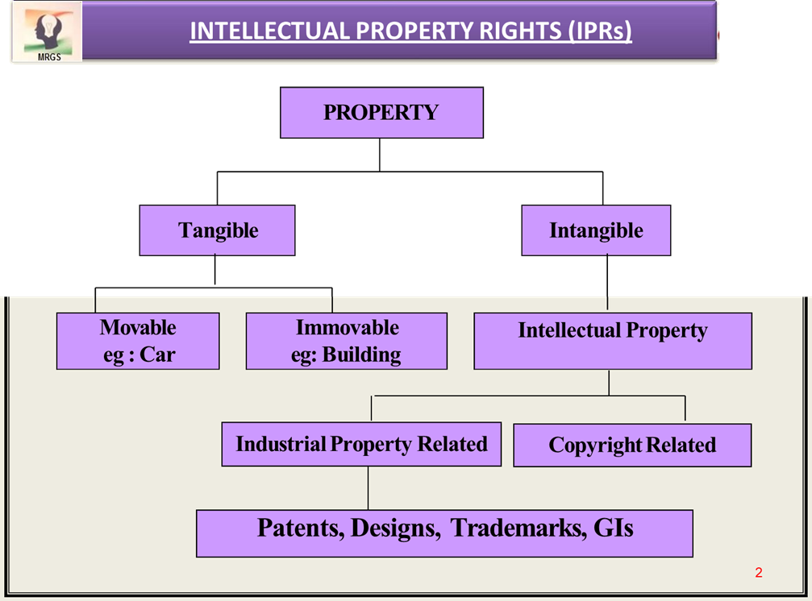
Types of IPR

Slide 6
INTELLECTUAL PROPERTY RIGHTS (IPRs): Purpose
The intellectual property rights were essentially recognized and accepted all over the world due to some important reasons.
To provide an incentive to individuals for new creations
To accord due recognition to the creators and inventors
To ensure material reward for intellectual property
To make available genuine and original products.

Slide 7
EVOLUTION OF IP ACTS AND TREATIES
1883 – Paris Convention (France): This international agreement is the first major step taken to help creators ensure that their intellectual works are protected in other countries.
The need for international protection of intellectual property (IP) became evident when foreign exhibitors refused to attend the International Exhibition of Inventions in Vienna, Austria in 1873 because they were afraid their ideas would be stolen and exploited commercially in other countries. The Paris Convention covers:
Inventions (patents)
Trademarks
Industrial designs

Slide 8
EVOLUTION OF IP ACTS AND TREATIES
1886 – Berne Convention (Switzerland): Following a campaign by French writer Victor Hugo the Berne Convention for the Protection of Literary and Artistic Works is agreed.
The aim is to give creators the right to control and receive payment for their creative works on an international level. Works protected include:
Novels, short stories, poems, plays;
Songs, operas, musicals, sonatas; and
Drawings, paintings, sculptures, architectural works.

Slide 9
EVOLUTION OF IP ACTS AND TREATIES
1891 – Madrid Agreement (Spain): With the adoption of the Madrid Agreement, the first international IP filing service is launched: the Madrid System for the international registration of marks.
In the decades that follow, a full spectrum of international IP services will emerge under the auspices of what will later become WIPO (World Intellectual Property Organization).

Slide 10
EVOLUTION OF IP ACTS AND TREATIES
1893 – BIRPI established
The two secretariats set up to administer the Paris and Berne Conventions combine to form WIPO's immediate predecessor, the United International Bureaux for the Protection of Intellectual Property – best known by its French acronym, BIRPI.
"Bureau international réunis pour la protection de la propriété intellectuelle,"
The organization, with a staff of seven, is based in Berne, Switzerland.

Slide 11
EVOLUTION OF IP ACTS AND TREATIES
1970 – BIRPI becomes WIPO
The Convention establishing the World Intellectual Property Organization (WIPO) comes into force and BIRPI is thus transformed to become WIPO.
The newly established WIPO is a member state-led, intergovernmental organization, with its headquarters in Geneva, Switzerland.

Slide 12
EVOLUTION OF IP ACTS AND TREATIES
1974 – WIPO joins the UN
WIPO joins the United Nations (UN) family of organizations, becoming a specialized agency of the UN. All member states of the UN are entitled, though not obliged, to become members of the specialized agencies.
193 Member Countries in UN today

Slide 13
EVOLUTION OF IP ACTS AND TREATIES
1978 – PCT System launched
The PCT international patent system begins operation. The PCT expands rapidly to become WIPO's largest international IP filing system today. The Patent Cooperation Treaty (PCT) makes it possible to seek patent protection for an invention simultaneously in each of a large number of countries by filing an "international" patent application.

Slide 14
EVOLUTION OF IP ACTS AND TREATIES
TRIPS (Trade-Related Aspects of Intellectual Property Rights) Agreement India along with other emerging nations graced a signatory to the Treaty of TRIPS of the World Trade Organisation (WTO) in 1995 with a matter that agreement will allow free flow of trade, investment and eliminate the restrictions enduring in the norm of Intellectual Property.

Slide 15
EVOLUTION OF IP ACTS AND TREATIES
The Agreement on Trade Related Aspects of Intellectual Property Rights (TRIPS) is an international agreement administered by the World Trade Organization (WTO) that sets down minimum standards for many forms of intellectual property (IP) regulation as applied to nationals of other WTO Members.
The TRIPS Agreement aims for the transfer of technology and requires developed country members to provide incentives for their companies to promote the transfer of technology to least-developed countries in order to enable them to create a sound and viable technological base.

Slide 16
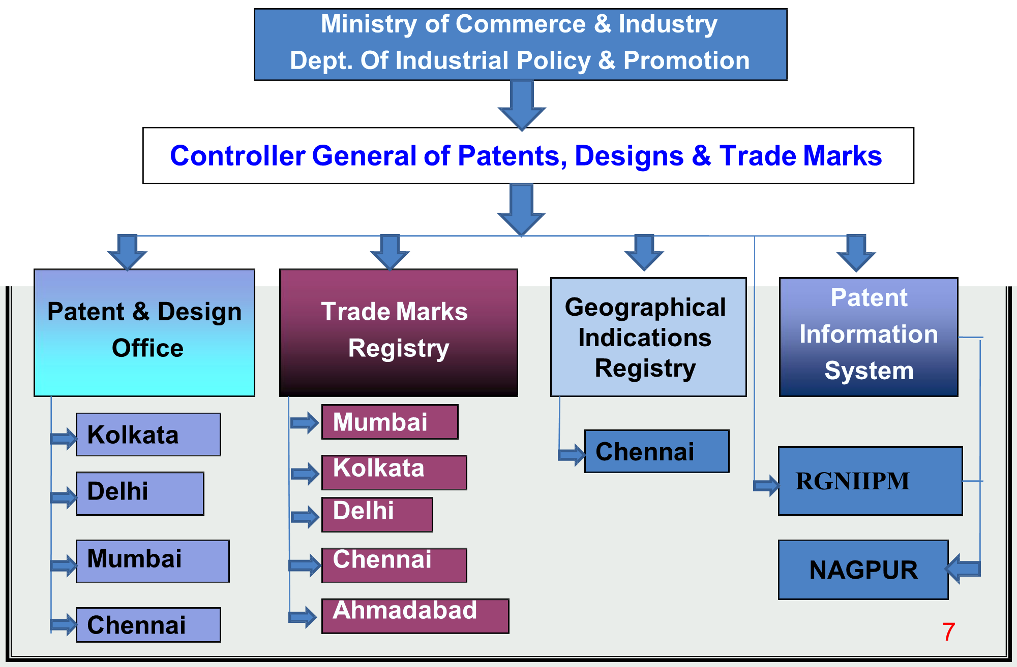
AGENCIES RESPONSIBLE FOR IPR REGISTRATIONS: National IPR Agencies
RGNIIPM: Rajiv Gandhi National Institute of Intellectual Property Management (Nagpur)

Slide 17
AGENCIES RESPONSIBLE FOR IPR REGISTRATIONS: National IPR Agencies
Mumbai Patent Office Jurisdiction
The States of Gujarat, Maharashtra, Madhya Pradesh, Goa, Chhattisgarh, the Union Territories of Daman & Diu, and Dadra & Nagar Haveli fall under the Mumbai Patent Office jurisdiction.
Delhi Patent Office Jurisdiction
The States of Haryana, Himachal Pradesh, Jammu and Kashmir, Punjab, Rajasthan, Uttar Pradesh, Uttarakhand, National Capital Territory of Delhi, and the Union Territory of Chandigarh fall under the Delhi Patent Office jurisdiction.

Slide 18
AGENCIES RESPONSIBLE FOR IPR REGISTRATIONS: National IPR Agencies
Chennai Patent Office Jurisdiction
The States of Andhra Pradesh, Karnataka, Kerala, Tamil Nadu, and the Union Territories of Pondicherry and Lakshadweep fall under the Chennai Patent Office jurisdiction.
Kolkata Patent Office Jurisdiction
The rest of India, the States of Bihar, Orissa, West Bengal, Sikkim, Assam, Meghalaya, Manipur, Tripura, Nagaland, Arunachal Pradesh, and Union Territory of Andaman and Nicobar Islands fall under the Kolkata Patent Office jurisdiction.

Slide 19
Intellectual Property Appellate Board (IPAB)
Intellectual Property Appellate Board (IPAB) has been established in the year 2003, under Section 84 of the Trade Marks Act, 1999.
The Board hears appeals against the decision of Controller of Patents (under the Patents Act, 1970), Registrar of Trade Marks (under the Trade Marks Act, 1999) and Geographical Indication cases (under the Geographical Indication & Protection Act, 1999).
The Copyright Board and Plant Varieties Protection Appellate Tribunal function under the ambit of IPAB in accordance with their respective Acts and Rules.

Slide 20
AGENCIES RESPONSIBLE FOR IPR REGISTRATIONS: International IPR Agencies
International Trademark Association (INTA): Its head quarter in New York City, INTA also has offices in Brussels, Shanghai and Washington DC and representative in Geneva and Mumbai.
More than 4000 (Present 6500 member) companies and law firms more than 150 (Present 190 countries) countries belong to INTA, together with others interested in promoting trademarks. INTA members have collectively contributed almost US $ 12 trillion to global GDP annually.
The INTA is formed to protect and promote the rights of trademark owners, to secure useful legislation (the process of making laws), and to give aid and encouragement to all efforts for the advancement and observance of trademark rights.

Slide 21
AGENCIES RESPONSIBLE FOR IPR REGISTRATIONS: International IPR Agencies
World Intellectual Property Organization (WIPO): Around 193 nations are members of WIPO. Its headquarters in Geneva, Switzerland, current Director General of WIPO is Daren Tang took charge on October 1, 2020.
purposes are to promote intellectual property throughout the world and to administer 23 treaties (Present 26 treaties) dealing with intellectual property.

Slide 22
VALIDITY OF IPR
SI No. | IPR | Maximum Protection | Renewal | Act/Rule
1 | Patent | 20 Yrs | *Every year (mandatory) | The Patents Act,1970 Amended in 2005
2 | Trade Mark | Life long | After 10yrs | The Trade Marks Act, 1999 Amended in 2010
3 | Design | 15 Yrs | After 10 years for next 5 years | The Designs Act, 2000 & Designs (Amendment) Rules, 2014
4 | Copyright | 60 years | Not require | The Copyright Act, 1957 Amended in 2012
5 | Geographical Indication (GI) | Life long | After 10 Yrs | The Geographical Indications of Goods (Registration and Protection) Act, 1999
*Patents will cease and be transferred to public domain if Patents are not renewed within 6 month of expiry of concerned year by paying renewal fee.

Slide 23


RELATION BETWEEN IPRs: Example
The logo Coca-Cola is an example for TRADE MARK.
Shape of the bottle – an INDUSTRIAL DESIGN.
PATENT may have been obtained in respect of bottling equipment.
COPYRIGHT – in respect of the text, database or artistic work appearing on its website.
i.e., A single product can be protected by more than one IPR.

Slide 24


Slide 25
PATENTS
It is the exclusive right of inventor to prevent others from possessing, using, selling, manufacturing and importing the patented invention or offering to do any of these with in a definite geographical area.
Patents have territorial jurisdiction i.e., we have to register the patents in all countries where we have our interests.
Patent application can be filed online in India by inventor or his assignee on www.ipindia.nic.in

Slide 26
PATENT ACT & RULES
In India, Patent rights are governed by the Patents Act, 1970. At present 3rd amendment of Act known as the Patent (Amendment) Act, 2005 is in force.
For application of Patents Act, rules are made by the Government, which are known as “Patent Rules, 2003”, as of now Patent (Amendment) Rule, 2006 and further updated in Sept’2015 are in force.
For better understanding of Act & Rules, “Draft Manual of Patent Practice & Procedure (MPPP), 2008” is made by the patent office.
There are 4 patent offices in India having work distribution according to their geographical location viz. Kolkata, Delhi, Mumbai & Chennai

Slide 27
PATENT ACT & RULES
Criteria of Patentability:
Novelty
Inventive step or it must be non-obvious
Capable of industrial application
Not fall within the provision of section 3 & 4 of the Patents Act 1970
Patents Act 1970:
Section3: List which are not inventions
Frivolous or obvious
Contrary to well established natural laws
Injurious to Public Health
Mere arrangement or re-arrangement,
Discovery of Scientific principle
Discovery of living thing or non-living substances in nature
Method of agriculture or horticulture
A mathematical or business method or a computer program
Section4: Not-patentable: Atomic Energy related

Slide 28
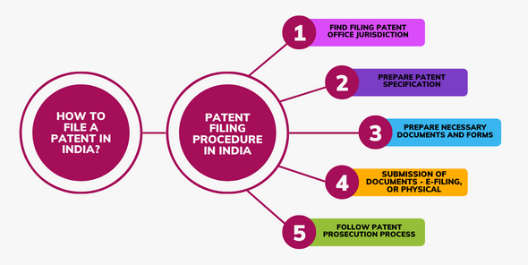
Patent Filing in India

Slide 29
PATENT FILING
Patent protection is a territorial right and therefore, it is effective only within the territory of India.
There is no concept of global patent.
However, filing an application in India enables the applicant to file a corresponding application for same invention in convention countries or under PCT, within or before expiry of twelve months from the filing date in India.
Patents should be obtained in each country where the applicant requires protection of his invention.

Slide 30
Physical Documents for applying at Indian Patent Office
1) Form-1: Application for grant of a patent [in duplicate]; 2) Form-2: Provisional or complete specification. If the provisional specification is filed, it must be followed by the complete specification within 12 months [in duplicate]; 3) Drawings (if necessary) [in duplicate]; 4) Form-3: Statement and undertaking for the corresponding foreign patent applications [in duplicate]; 5) Form-5 Declaration of inventorship: This is submitted either with the provisional specification followed by the complete specification or, in the case of convention/PCT national phase applications [in duplicate]; 6) Form-9: Request for early publication (optional) [in duplicate]; 7) Form-18: Request for examination (optional) [in duplicate]; 8) Form-26: A power of attorney (if filed through a Patent Agent) [Form-26]; 9) statutory patent fees – DD/Cheque; and

Slide 31
Physical Documents for applying at Indian Patent Office
10)A certified copy of the priority document (In case priority is claimed). Priority documents must be filed in the following cases:
-Convention application (under Paris Convention); -PCT National Phase application wherein requirements of Rule 17.1(a or b) has not been fulfilled -Priority documents must be filed along with the application or before the expiry of 18 months from the date of priority to enable the early publication of the application.

Slide 32
Documents required for E-filing
i) Pre-requisites:
-Login ID and password; -Digital signature; and -Valid debit/credit/net banking facility
ii) All the necessary physical documents mentioned above in PDF format; iii) Statutory fee via the payment gateway.
Hard copies of the requested documents duly signed by the applicant/agent should be sent to the jurisdictional patent office if requested by the controller.

Slide 33
INTERNATIONAL PATENT FILING
As per Section 39 of the Indian Patent Act, any inventor of India seeking for International patent are required to file the patent application initially in India.
Upon patent application filing in India, the inventor can request for an International patent application within twelve months of the date from the filing of the first patent application.
The application for permission for making patent request outside India should be made in Form-25.

Slide 34
Prescribed documents required at the time of filing Foreign Filing License
A description of the invention that sufficiently describes the inventive concept known to the applicant at the time of requesting FFL. Invention title along with drawings (if any) has to be provided.
Form 25- Application for permission for performing patent license outside India.
Declaration of the invention, along with the foreign filing license (FFL) form.
Name and address of inventor’s who are resident in India.
Countries name in which the invention has to be filed and the reason for making such an application.

Slide 35
Prescribed documents required at the time of filing Foreign Filing License
Name and addresses of the assignee, if applicable.
The name of the country or countries in which the patent application is expected to be filed after obtaining the foreign filing license from the Indian patent office.
Power of Attorney from the inventor’s or the applicant who are resident in India, where a patent attorney is appointed to describe them before the Indian Patent Office.
Form 28- In the event of the applicant is a small entity.
https://ipindia.gov.in/writereaddata/Portal/IPOFormUpload/1_37_1/form-25.pdf
https://ipindia.gov.in/writereaddata/Portal/IPOFormUpload/1_40_1/form-28.pdf

Slide 36
Process of Patent Registration in India
Step 1: Filing A Patent Application
Patent documents can be filed either online or at the patent office in respective jurisdictions: Kolkata, Delhi, Mumbai, and Chennai.
Basic types of applications:
Provisional application: Inventors usually opt for provisional application when their idea is in the research and development stage. The specification document contains a simple description of the invention. However, the inventor should file the complete patent specification document within 12 months of submitting the provisional application.
Complete application: When an inventor has the complete invention while applying for a patent, he can file a complete application. Chapter III, Section 10 of the Indian Patent Act, outlines the structure of the specification document.

Slide 37
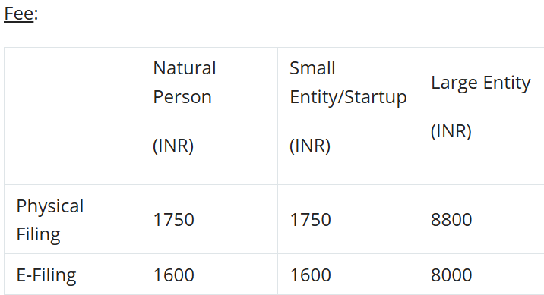
Step 2: Publication
The patent office publishes the application 18 months from the filing date or priority date in the patent journal. This publication is automatic and does not require any intervention from the applicant. However, the applicant can request an early publication through Form 9. In such cases, usually, the Office publishes the patent within a month of requesting it.

Slide 38
Step 3: Request for Examination (RFE)
After filing a patent application, the applicant needs to submit an examination request. We can file this request through Form 18, and the controller will transfer the application to the patent examiner for further examination. Generally, the applicant should submit the request for examination within 48 months of filing the application or priority date. Moreover, this deadline is crucial because if we do not file a request for examination within the time limit, the Office will consider the application withdrawn.
And also, an expedited examination is another provision provided.

Slide 39
Step 4:Patent Examination
The Controller will transfer the application to the examiner within one month of the request for examination. Firstly, the patent examiner will thoroughly examine the patent and ensure that the invention is patentable and complies with The Patent Act. Furthermore, the examiner will issue the First Examination Report (FER) to the applicant or authorized agent within two months of receiving the file.
The examiner may raise objections regarding the patent application in the FER report. The FER generally includes a summary of the report, a detailed technical report with a list of cited documents for novelty, inventive steps, and other formal requirements. These days the examination reports are issued by email, and where no email is available, the examination report shall be dispatched by post.
The applicant should respond to these objections within six months of the report. Likewise, some guidelines for responding to a First Examination Report can be found in the article procedure to file a response. However, the applicant can also request an extension to respond to the objections for three months via Form 4. Meanwhile, if the applicant fails to respond within the stipulated time, the Indian Patent Office will consider the application abandoned.

Slide 40
Step 5: Examination Response
Once the patent application examination is conducted, and objections are generated in the FER, the applicant is expected to respond to the objection present within six months from the date of the examination report.
The FER may also contain some objections under Sec 9, 10, 57, and 59 of the Patents Act, 1970, which lists the format-related requirements of the specification, drawings, and other enclosures of the Patent Application. These need to be addressed as well.
Incorrect, delayed, or improper response to the FER can prove detrimental to your patent application. Therefore, it is imperative to address all the objections accurately to ensure a quick patent grant.
The applicant can amend the claims to overcome the objection.

Slide 41
Step 6: Grant of Patent
Finally, once the patent application overcomes all the objections, the patent office grants the patent and publishes it in the patent gazette. The patent office issues intimation concerning the acceptance of the application. Within seven days of approval, a grant certificate is issued via email.
Step 7: Renewal of patent
The renewal fee shall be payable at the expiration of the second year from the date of the patent or any succeeding year to keep the patent in force. You can find further details concerning the patent renewal and fees applicable here.

Slide 42
Opposition (Optional)
As soon as the publication of the patent application and the filing of the request for examination is complete, any third party can file a pre-grant opposition. In comparison, only an interested party can file a post-grant opposition within 12 months of the granting of the patent. An interested party refers to any company in a similar field of business.
Firstly, an Opposition Board receives the objections and evidence from the third party. It carefully scrutinizes the evidence from the opposition and the patent holder’s response to the opposition. Then, it submits its recommendation to the Controller. Usually, the patent office decides to maintain, amend, or revoke the patent via a hearing. It ensures that the patent cannot proceed with the grant unless the opposition is set aside.
There is no fee chargeable by the patent office on filing the pre-grant opposition, whereas the below-mentioned provides fee particulars for filing the post-grant opposition:

Slide 43
Prescribed fee for applying FFL
Patent Application for permission for performing patent application outside India | E-filing |  |  | Physical filing
 | Normal person | Small entity | Other than a small entity | Normal person | Small entity | Other than a small entity
 | Rs.1600 | Rs.4000 | Rs.8000 | Rs.1760 | Rs.4400 | Rs.8800

Slide 44
Who can file a Patent Application?
By any person claiming to be the true and first inventor(s)
By any person being the assignees of a person claiming to be the true and first inventor(s)[proof of assignment has to be submitted with the application]
By the legal representative of any deceased person or assignee

Slide 45
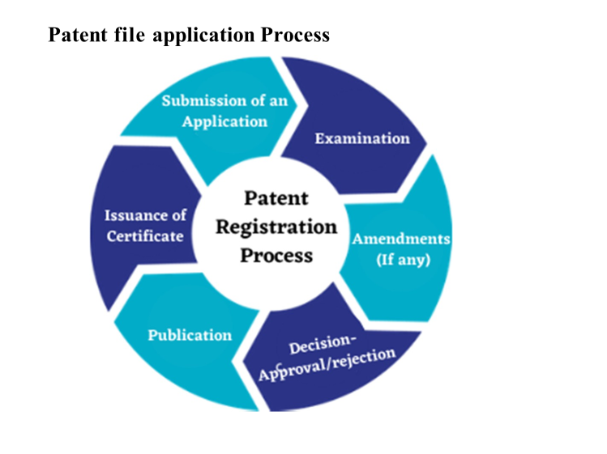
Patent File Application Process

Slide 46
Rights and Obligations of the Patentee
Rights of Patentee
Right to Exploit Patent: In India, the patentee is granted the right to use, market and distribute the protected goods or exercise the method if the patent is for a person. The right given can be provided either by the patentee himself or by his agent or licensees. Patentee can only exercise the rights during the term of the patent.
Right to Grant License: Patentee has a discretion to grant license to third parties for the purpose of distributing and producing the protected goods. For a license to be legitimate and valid, it must be in written form and lodged with the Patent authority.
Right to Surrender: Patentee has the power to abandon the patent after appropriately asking for authorisation from the controllers. The controller transfers ownership only after evaluating the claims of the parties. The application for surrender is also mentioned in the Official Gazette to enable interested persons to oppose.
Right to Sue for Infringement: Patent Infringement refers to any breach of a patent holder's rights. Hence, patentee has a right to institute proceedings for infringement of the patent and if the defendant is found guilty of infringement, the court may order compensation or a long term order.

Slide 47
Obligations of Patentee
Government use of Patents: A patented invention may be used by the government for its use only and the patent holder is prohibited from using the innovation for personal gain or claiming a monopoly over commercial activities under this barrier. In case of a patent in respect of medicines or drugs, it may be imported by the government for its own use or for distribution in any hospital, dispensaries or medical institutions run by or on behalf of the government.
Revocation of Patent: In cases of unsatisfactory result to the demand of public in respect of the patented invention, a patent may be revoked in such cases.
Invention for Defence Purpose: In certain cases, publications of inventions are restricted by directions of controller, hence are subjected to certain secrecy provisions. In continuation of such prohibition of patented invention, the application is debarred for using it and it might be used on payment for royalties by the Central Government.
Restored Patents: A patent can be restored once lapsed, provided that few limitations are imposed on the right of the patentee.

Slide 48
Patent Infringement
Patent infringement occurs when another party makes unauthorised use, production, sale or offer of sale of a subject matter without the patent holder's permission.
The idea behind patent infringement is that unauthorised parties are not permitted to use patent without the patent holder's permission.
In the patent infringement cases, the court usually compares the subject matter covered under the patent with the subject matter that is used by the infringer. Infringement may occur directly or indirectly.

Slide 49
Remedies for Patent Infringement
Injunction: infringing party to stop making use of infringing product. Injunction is a stay order that stops the It aims at preserving the patent's value and preventing further harm to the patent holder. In order to obtain an injunction, the patent holder has an obligation to prove that their patent is valid and has been infringed by the defendant.
Damages: The patent owner may obtain damages in respect of loss caused due to infringement.
Seizure of Forfeiture of Infringing Goods: Court may order that the items determined to be infringing must be taken into custody, disposed of, or forfeited as deemed.

Slide 50

Industrial Design

Slide 51
Industrial Design
A Design refers to the features of shape, configuration, pattern, ornamentation or composition of lines or colours applied to any article, whether in two or three dimensional (or both) forms.
Design does not include any mode or principle of construction or anything which is a mere mechanical device.
It also does not include any trade mark or any artistic work.

Slide 52
Benefits of Design Registration
A registered proprietor of the design is entitled for protection of his intellectual property.
He can take step against infringement, if his right is infringed by any person. He can license or sell his design as legal property for a consideration or royalty.
Registration initially confers this right for ten years from the date of registration. It is renewable for a further period of five years.
If the fee for extension is not paid for the further period of registration within the period of initial registration, this right will cease.
There is provision for the restoration of a lapsed design if the application for restoration is filed within one year from the date of cessation in the prescribed manner

Slide 53
Essential requirements for Design Registration
A design should
Be new or original registration
Not been disclosed to the public anywhere by publication in tangible from or by use or in any other way prior to the filling date, or where applicable, the priority date of the application for registration.
Be significantly distinguishable from known designs or combination of known designs.
Not comprise or contain scandalous or obscene matter.
Not be a mere mechanical contrivance.
Be applied to an article and should appeal to the eye.
Not be contrary to public order or morality

Slide 54
Exclusion from scope of design
Designs that are primarily literary or artistic character are not protected under the Designs Act. These will include :
books, calendars, certificates, forms-and other documents, dressmaking patterns, greeting cards, leaflets, maps and plan cards, postcards, stamps, medals.
labels, tokens, cards, cartoons.
any principle or mode of construction of an article.

Slide 55
Who can apply for registration of a Design ?
Any person or the legal representative or the assignee can apply separately or jointly for the registration of a design.
The term "person" includes firm, partnership, small entity and a body corporate.
An application may also be filed through an agent in which case a power of attorney is required to be filed.

Slide 56
A ten step guide application for industrial design
Step 1 Finding out whether any registration already exists
The Designs office can assist you to search whether the design has been previously registered. If the registration number is known, Form No.-6 should be filed along with the prescribed fees of Rs. 500. If the representation of the article or the specimen of the article is filed Form No.-7 along with the prescribed fees of Rs. 1,000 is required.
Step 2 Preparing a representation of the design
A representation is the exact representation of the article on which the design has been applied. It should be prepared on white A4 size paper of durable quality. Do not prepare it on cardboard or mount it on other paper. Indicate details of the design and applicant clearly.

Slide 57
A ten step guide application for industrial design
Step 3 Identifying the class of design
Designs are required to be categorized in separate classes in order to provide for systematic registration. An internationally accepted classification of Industrial Designs based upon the function of the article is required. The class and sub-class should be mentioned in the application. There are 32 classes and most of the classes are further divided into sub-classes.
Step 4 Providing a statement of novelty
A statement of novelty should be included on the representation of a design as per the Act in order to specify the claim. This will enable speedier examination and provide a more specific protection. The claim will protect the overall visual appearance of the design as described in the representation of drawing.

Slide 58
A ten step guide application for industrial design
Step 5 Including a disclaimer
If the ornamental pattern on an article is likely to be confused with a trade mark, suggests any mechanical action or contains words, letters, numerals, etc., a disclaimer should be included in the representation.
Step 6 Claiming a priority date
If you have applied for protection of the design in convention countries or countries which are members of inter-governmental organizations, you can claim registration of the design citing a priority date in India. This is the date of filing of the application in any of such countries provided the application is made in India within six months

Slide 59
A ten step guide application for industrial design
Step 7 Determining the fee to be paid
Applications are to be accompanied by the required fee through cheque or draft payable at Kolkata or in cash (if filed in Design Office, Kolkata). Application for the registration of design is Rs 1,000 and for renewal it is Rs. 2,000.
Step 8 Ensuring all enclosures are attached
File an application only after ensuring that all enclosures and fee in the required numbers are attached. Applications can be filed in either the Design Office in Kolkata or the branch offices of the Patent office in Delhi, Mumbai or Chennai.

Slide 60
A ten step guide application for industrial design
Step 9 Complying with objections (if any)
If the Design Office seeks additional information or clarifications after preliminary examination, please ensure that these are provided promptly. This will help the office to take up your application for early examination.
Step 10 Providing full details
While filing an application make sure that all contact details and addresses are clearly and legibly filled in. This will enable the office to keep in touch with you and convey decisions.

Slide 61


Trade Mark and Trade Secret

Slide 62
Trademark
Trademarks are special unique signs that are used to identify goods or services from a certain company.
They can be designs, pictures, signs or even expressions. It is important because it differentiates your products from the competitions.
It can be associated with your brand or product. Trademarks are classified as intellectual property and therefore is protected from infringement.
Trademarks and its rights are protected by the Trademark Act, 1999.

Slide 63
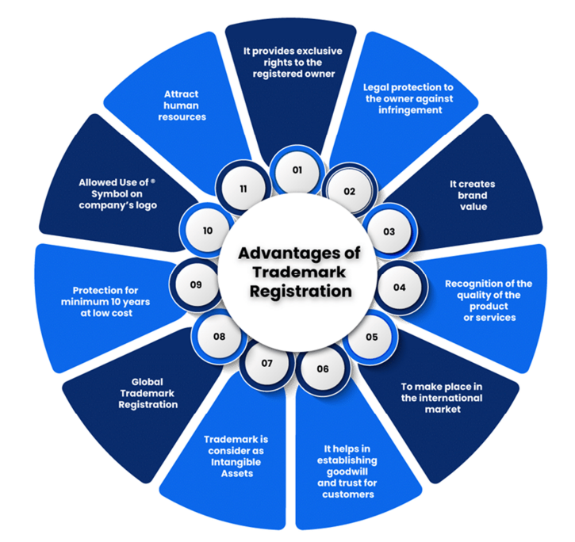
Benefits of Trademark Registration

Slide 64
Need of Registration
To get the protection of trademark rights one has to register the trademark. It is important to register your trademark because it prevents others from copying your mark and misrepresenting other products with your mark. Trademarks help the customers to recognise the brand and the brand value in one look such as the logo of a tick sign for Nike or a jumping wildcat for Puma etc.
Unlike patents, trademark does not have a definite limitation period. Where a patent expires in 20 years a trademark registration expires after 10 years of its registration, but unlike patents, a trademark can be renewed again for another 10 years.
This process can be indefinitely done, meaning as long as you keep renewing the trademark it will not expire and will continue to be under the protection of the Act.

Slide 65
Trademark Types
Word Marks: These are the simplest form of trademarks, that consists of words, letters, or numbers. Some wordmark examples include iconic brand names like Coca-Cola or Google.
Design Marks: Visual elements, like logos, graphics, or any symbols, make up design marks. Some top examples of design marks are the Nike swoosh and Apple’s bitten apple.
Combined Marks: These combine both words and design elements. Famous examples of combined marks include the McDonald’s golden arches with the brand name.
Slogan Marks: Catchy and memorable phrases or slogans that uniquely identify a brand come under this category of slogan marks. Think of Nike’s “Just Do It” or McDonald’s “I’m Loving’ It.”
Product Packages: This extends beyond traditional trademarks to cover the overall appearance and feel of a product or its packaging. The distinctive shape of the Coca-Cola bottle is a notable trade dress example.
Sound Marks: Recognizing that brands can be auditory experiences too, sound marks protect distinctive sounds associated with a brand. The Intel jingle is a classic sound mark.
Color Marks: Specific colors associated with a brand can be protected as trademarks. Think of the distinctive Tiffany blue or UPS brown.

Slide 66
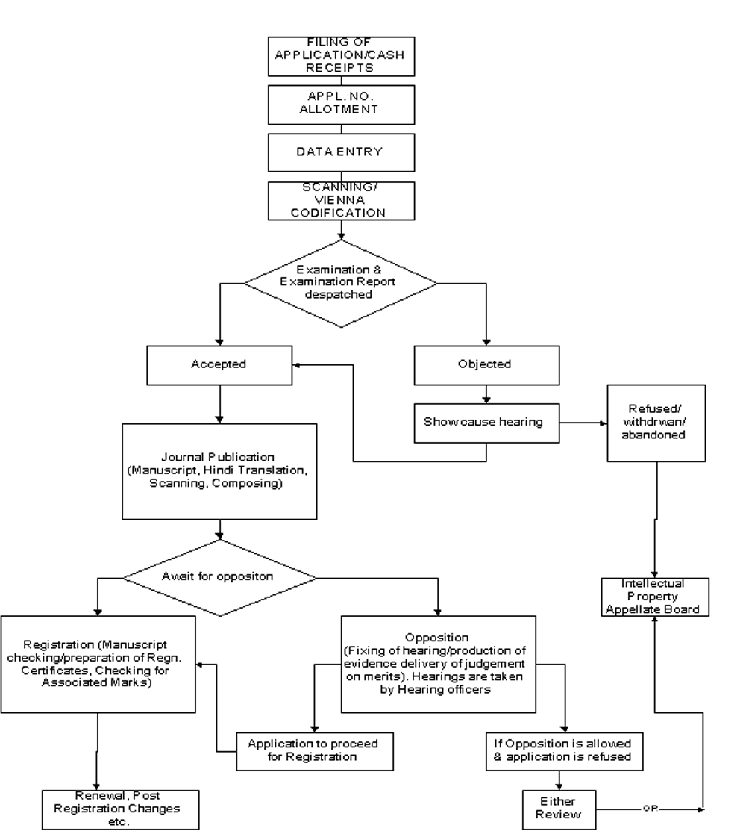
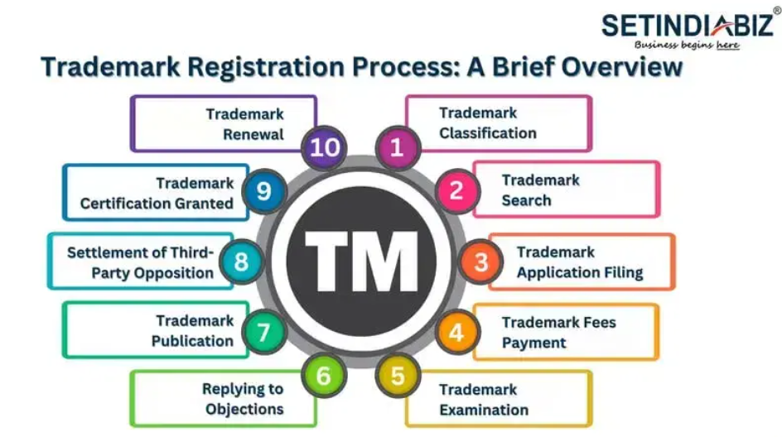
Trademark Filing Procedure

Slide 67
Stepwise Guide to Trademark Registration Process
Step 1: Trademark Classification
The Nice Classification System comprises 45 classes of goods and services, where classes 1 to 34 represent goods and while the remaining ones represent services.
Step 2: Trademark Search
This step involves searching local and international databases to check if there are any similar or identical marks that could create a challenge while registering your desired mark. A deep trademark search not only helps minimize the risk of objections during the examination/review process but also helps businesses in making informed decisions about the uniqueness and viability of their chosen mark.

Slide 68
Stepwise Guide to Trademark Registration Process
Step 3: Trademark Application Filing
Once all the prerequisites have been fulfilled, the next step of the trademark registration process is to file a trademark application. The application is submitted online to the relevant intellectual property office, requesting an examination as well as approval of the mark. It includes necessary details such as the applicant’s information, a representation of the mark, and the specified class of products/services for which it is intended to be used.

Slide 69
Stepwise Guide to Trademark Registration Process
Step 4: Trademark Fees Payment
In India, the registration fee for trademarks ranges between Rs. 4500 to Rs. 9000. For start-ups, small enterprises, individuals and proprietorships, the lower trademark registration fee of Rs. 4500 is applicable and for all other business entities, the trademark registration fee as set by the government is Rs. 9000.
Step 5: Examining the process of the brand name application
Once the application is dispatched, the Registrar of Trademark will check out whether you have followed certain terms and that your brand name complies with, the existing law. Moreover, there should not be any similarity or identical with any existing or pending brands for the registration. This is the reason why we preferred you to choose a quirky brand name!

Slide 70
Stepwise Guide to Trademark Registration Process
Step 6: Replying to Objections
Addressing objections raised during the examination stage is extremely crucial to take the trade mark registration process further. The applicant must respond to the objections within 30 days from the date on which they were raised.
If the examiner is satisfied, they will proceed to the next stage. However, if unsatisfied, the examiner may summon a show cause hearing to resolve the issue.
Step 7: Publication of your brand in the Indian Trade Mark Journals
After the process of examination, the Registrar of Trademark will publish your brand name in the Indian trademark journal. This is certainly the most important part of the trademark registration and there should not be any opposition within 4 months from the date of publication. When there is no opposition, the Registrar of Trademark will proceed towards issuance of Trademark Registration Certificate.

Slide 71
Stepwise Guide to Trademark Registration Process
Step 8: Settlement of Third-Party Opposition
In instances where third parties raise objections or oppositions during the specified period, resolution becomes a critical aspect of the trademark registration process. This step involves negotiation, settlement, or legal proceedings to address the concerns raised by opposing parties. Only after a successful resolution of all public oppositions, the department will consider proceeding with the application.
Step 9: Trademark Certification Granted
The last milestone of the trade mark registration process step by step is achieved when the applicant is granted a Trademark Certificate. This official document serves as tangible proof of the exclusive rights conferred to him. Once issued, it remains valid for 10 years from the date of application.
Throughout this period, the Trademark remains protected against unauthorised use and plagiarism.

Slide 72
Stepwise Guide to Trademark Registration Process
Step 10: Trademark Renewal
Trademark protection is not everlasting, and in the final step of the trademark registration process, trademark owners must renew their trademarks to maintain their rights. Failing to the trademark renewal before the deadline, may result in the loss of protection. The renewal process is almost similar to the original registration process. There is no predefined limit on how many times a trademark can be renewed.

Slide 73
Stepwise Guide to Trademark Registration Process
Step 11: The trademark registration certificate issuance
The Registrar will accept your trademark application if there’s no opposition being raised within the stipulated period of 4 months or on acceptance of your trademark application after trademark opposition hearing. Wow! And this will be the happiest moment for you as the Registrar issues the Registration Certificate with the Trademark Registry seal.
Right from the moment you have been issued with your certificate, you can use the registered trademark symbol (®) beside your brand name.

Slide 74
Documents required for a trademark registration
Documents required in Individual & Sole proprietorship
Copy of the proposed logo, ideally in black and white (which is optional). However, in case the logo is not provided, the trademark application can be filed for the word.
Duly signed Form- 48. This form is an authorisation from the applicant to a Trademark Attorney to file the trademark registration application on his/ her behalf.
Copy of the identity proof of the individual applicant or the proprietor which may include: passport, Aadhaar card, PAN card, etc.
Copy of the address proof of the individual applicant or the proprietor which may include latest electricity bill, phone bill, etc.

Slide 75
Documents required for a trademark registration
Documents required in partnership / LLP / company - Small Enterprises or Start-ups
Scanned copy of the logo (optional)
Duly signed Form- 48
Udyam Registration Certificate
Partnership Deed or the Incorporation Certificate • Copy of identity proof of signatory/ applicant
Copy of address proof of signatory/ applicant

Slide 76
Documents required for a trademark registration
Documents required for other applicants in a trademark registration
Scanned copy of the logo (optional)
Duly signed Form- 48
Partnership Deed or the Incorporation Certificate • Copy of identity proof of signatory/ applicant
Copy of address proof of signatory/ applicant

Slide 77

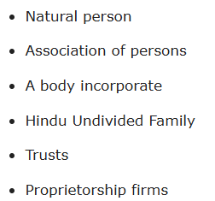
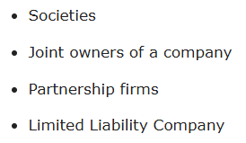

Slide 78
Trade Secret
Trade Secrets are the secrets or concepts of any business that keep them successful. For example, Trade Secrets are intellectual property consisting of formulas, processes of manufacturing, ingredients of the recipe, tools used, designs, or any other information that has an economic value in the business.
The other word for Trade Secret is also Confidential Information that gives the organization an upper hand over its competitors. The three key elements of Trade Secret are:
They aren’t available to the general public.
Their possessor benefits financially from their concealment.
Their confidentiality has rigorous protection.

Slide 79


Copyright

Slide 80
Copyright
Copyright is the legal ownership of intellectual property such as original works of fiction and non-fiction and conveys the right to control its reproduction and distribution.
In other words, copyright is the right to copy. Only the creator of the work can authorize anyone to reproduce the work.
Copyright law gives creators of original material the exclusive right to use and duplicate that material for a given amount of time. Once a copyright expires, the copyrighted item enters the public domain.

Slide 81
Examples of Copyrights
Books, poems, plays, and other literary works
Musical compositions, sound recordings, and other audio works
Paintings, sculptures, and other visual works
Computer programs, databases, and other software
Architectural works, maps, and technical drawings

Slide 82
Examples of Copyrights
Literary Works (Excluding Computer Programs): This category encompasses many written creations, from novels and poetry to essays, articles, and more.
Musical Works: Musical compositions, including melodies, lyrics, and sheet music, fall under this category.
Artistic Works: Visual creations such as paintings, sculptures, drawings, and other artistic expressions enjoy copyright protection.
Cinematography Films: Copyright extends to films, ensuring the protection of audio-visual works.
Sound Recordings: This category covers the audio recordings of music, speeches, and various other sound-based creations.
Digital innovations, Tables, and Compilations: Software, data compilations, and tables are safeguarded by copyright, ensuring the protection of digital innovations.

Slide 83
Copyright Office
Boudhik Sampada Bhawan, Plot No. 32, Sector 14, Dwarka, New Delhi-110078 Telephone No.: 011-28032496

Slide 84
Time Period
In case of original literary, dramatic, musical, and artistic works the time period of copyright in India is 60 years in addition to the author’s lifespan.
Where there are multiple authors, the term is 60 years post the death of the last author.

Slide 85
Benefits of copyright
Copyright encourages and rewards creativity
Copyright protects the rights of authors and performers
Copyright protects the rights of producers of sound recordings and broadcasting organizations

Slide 86
Steps in the copyright filing process
Step 1: Access the official website
Visit the Official website of the Copyright Office. Log in with your valid User ID and Password. If you still need to register, click on "New User Registration. Make sure to note down your User ID and Password for future reference.
Step 2: Submission of Application
An application containing all the necessary particulars and a statement of the particulars must be prepared in the prescribed format (FORM XIV).After logging in, click the "Click for Online Copyright Registration" link. The online "Copyright Registration Form" requires completion in four steps:
Fill out Form XIV, then click "SAVE" to save your entered details, and proceed to Step 2.

Slide 87
Steps in the copyright filing process
Prepare a scanned copy of your signature for uploading.
Complete the "Statement of Particulars" and click "SAVE" to save your entered details.
Fill out the "Statement of Further Particulars. This form applies to "LITERARY/DRAMATIC, MUSICAL, ARTISTIC, AND SOFTWARE" works. Click "SAVE" to store your entered details and proceed.
Make Payment: This application and the requisite fees outlined in Schedule 2 of the Copyright Act are then forwarded to the copyright registrar. Use the Internet Payment Gateway to make the required payment

Slide 88
Steps in the copyright filing process
Step 3: Dairy Number Issuance
Upon receiving the application, the registrar will issue a Dairy Number, marking the initiation of the copyright registration process. Subsequently, there is a mandatory 30-day waiting period for any potential objections to be submitted. Finally, print one hard copy of each of the "Acknowledgement Slip" and the "Copyright Registration Form" and send them by post to the following address: Copyright Division
Department For Promotion of Industry and Internal Trade
Ministry of Commerce and Industry
Boudhik Sampada Bhawan,
Plot No. 32, Sector 14, Dwarka, New Delhi-110078
Email Address: copyright[at]nic[dot]in
Telephone No.: 011-28032496

Slide 89
Steps in the copyright filing process
Step 4: Copy Right Objection Handling
If no objections are raised within 30 days, a scrutinizer will assess the application for any discrepancies. If no discrepancies are found, the registration will proceed, and an extract will be provided to the registrar for entry into the Register of Copyright.
Step 5: Objection Resolution
If objections are received, both parties will receive a notification from the examiner outlining the objections. A hearing will be arranged to address these objections.

Slide 90
Steps in the copyright filing process
Step 6: Application Scrutiny
Following the hearing and the resolution of objections, the scrutinizer will meticulously review the application if applicable. Subsequently, they will either approve or reject the application, depending on the specific circumstances.
Step 7: Get a Copyright Registration Certificate
Once the application is approved, the relevant authority will issue the copyright registration certificate. In the usual course of events, the entire process typically takes approximately 2 to 3 months to complete.

Slide 91
Documents required for copyright registration
Two copies of the work
Proof of payment
Notification of consent (NOC) from the author, publisher, or other relevant parties
Power of attorney (if applicable)

Slide 92
Benefits of Copyright Registration
Safeguarding the Owner: Copyright registration provides copyright owners exclusive rights over their work, encompassing reproduction, distribution, adaptation, dissemination, and translation.
Legal Protection: Creators benefit from legal protection with copyright registration, ensuring their work cannot be reproduced without proper authorization.
Enhancing Brand Value: A registered copyright serves as proof of ownership, allowing creators to use it for marketing purposes and contributing to goodwill creation.
Global Reach: Copyright protection extends internationally. If a work is copyrighted in one country, it enjoys similar privileges in other countries, including India.

Slide 93
Benefits of Copyright Registration
Copyright as an Asset: Copyright is considered an intellectual property asset, making it an intangible resource that can be sold or licensed, adding economic value.
Owner Visibility: Copyright registration raises the work profile, making it accessible worldwide and searchable in copyright registries. It also prevents unauthorized use of the work once registered.
Economic Stability: Copyright registration promotes economic stability, enabling creators to reproduce and monetize their art in various forms, contributing to their financial well-being.

Slide 94
Legal Rights of a Copyright Owner
Claiming Authorship: You can claim authorship of your published work, asserting your paternity over the creation.
Reproduction and Storage: Copyright registration gives exclusive privilege to the owner to reproduce the work in any tangible form and store it in any medium through electronic means.
Control Over Publication: You can decide where and where not to publish your work, exercising the publication right.
Public Performance and Communication: The owner may publicly perform or communicate the work to the public through copyright registration. You also have the authority to create translations or adaptations of the original work.

Slide 95
Legal Rights of a Copyright Owner
Protecting Reputation: In case of any potential harm to your image or reputation, you have the right to take necessary preventive actions.
Selling or Transferring: The owner can sell or transfer the copyright, granting others the rights to use, reproduce, or adapt the work as specified in the transfer agreement.

Slide 96
New developments in IPR
AI and Machine Learning in IPR: With the rise of AI and machine learning technologies, there have been discussions and developments around how to handle intellectual property rights concerning AI-generated content, inventions, and algorithms. This includes issues related to patentability, ownership, and infringement.
Blockchain and IPR Management: Blockchain technology has the potential to revolutionize how intellectual property rights are managed, particularly in terms of copyright and digital rights management. Startups and companies are exploring blockchain-based solutions for copyright registration, licensing, and royalty distribution.

Slide 97
New developments in IPR
Global Harmonization Efforts: Efforts to harmonize intellectual property laws and standards across different jurisdictions continue, driven by international agreements and treaties such as the World Intellectual Property Organization (WIPO) treaties. This includes discussions on patent harmonization, trademark recognition, and copyright enforcement.
Biotechnology and Genetics: Developments in biotechnology and genetics raise new questions and challenges regarding the patentability and ownership of genetic materials, gene editing techniques like CRISPR (clustered regularly interspaced short palindromic repeats- is a genome-editing tool that allows scientists to modify DNA), and biopharmaceutical innovations. Legal frameworks are evolving to address these issues.

Slide 98
New developments in IPR
Green Technology and IPR: The push towards sustainable development and green technology has led to discussions about intellectual property rights in areas such as renewable energy, clean technology, and environmental innovation. Balancing IPR protection with the need for technology dissemination and access is a key consideration.
Digital Transformation and Copyright: The digital transformation of industries such as publishing, music, film, and software continues to shape copyright law and enforcement mechanisms. Issues like online piracy, fair use/fair dealing, and the liability of internet intermediaries are constantly evolving.

Slide 99
New developments in IPR
Data Protection and Privacy: The increasing importance of data protection and privacy laws, such as the GDPR in Europe, has implications for intellectual property rights, especially in relation to data ownership, data licensing, and data-driven innovations.
Open Access and Open Innovation: Movements towards open access publishing, open- source software, and open innovation models challenge traditional approaches to intellectual property rights. These developments raise questions about the balance between openness and proprietary rights in knowledge creation and dissemination. These are just a few potential areas where developments in intellectual property rights may be occurring. It's essential to stay updated with legal and technological trends in your specific industry or area of interest to understand the latest developments in IPR.

Slide 100
Thanks

